Slide 1
Computer Networks
CSE-AIT
Chapter 3.1
ALOK KUMAR – ASSISTANT PROFESSOR & KARGIL TECHINCAL TRAINER (DCPD)
EMAIL: DCPD.KARGILT1@CUMAIL.IN

Slide 2
Contents
Introduction to transport layer [Need, Process-to-process delivery, Transport Layer vs Network layer, Services of transport layer]
TCP
UDP

Slide 3
Responsibilities of Transport Layer
Functionality | Simple Explanation | Example
Process-to-Process Delivery | Delivers data to the correct application/process on the destination computer. | Data meant for a web browser should reach the browser, not another application.
Port Addressing | Uses port numbers to identify the sending and receiving applications. | A web server may use Port 80 (HTTP) or 443 (HTTPS).
Segmentation & Reassembly | Breaks large application data into smaller pieces for transmission and combines them again at the receiver. | A large file is divided into smaller TCP segments before being sent.
Multiplexing | Allows data from multiple applications to use the network at the same time. | Browser, email and another app can send data simultaneously.
Demultiplexing | At the receiver, delivers incoming data to the correct application using port information. | Data arriving for Port 443 is delivered to the application/socket using that port.
Connection Establishment | A connection-oriented protocol such as TCP establishes a connection before normal data transfer. | TCP uses the 3-way handshake: SYN → SYN+ACK → ACK.

Slide 4
Responsibilities of Transport Layer
Functionality | Simple Explanation | Example
Connection Release | Properly closes an established TCP connection after communication is finished. | TCP can use FIN and ACK messages to close the connection.
Reliable Data Transfer | Ensures data can be delivered correctly using mechanisms such as ACKs and retransmission. | If a TCP segment is lost, it can be sent again.
Ordered Delivery | Makes sure data is provided to the application in the correct order. | If TCP data arrives out of order, sequence numbers help restore the correct order.
Error Detection | Detects whether data was corrupted during transmission. | TCP and UDP use a checksum to detect errors.
Flow Control | Prevents a fast sender from sending more data than the receiver can handle. | If the receiver has only 4000 bytes of buffer space available, TCP can advertise a 4000-byte window.
Connection Management | Manages the complete TCP communication from starting the connection to closing it. | Establish connection → Transfer data → Release connection.

Slide 5
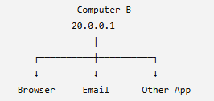
Introduction to Transport Layer
Why do we need a Transport Layer when the Network Layer already sends packets from source to destination?
we have studied that the Network Layer provides host-to-host delivery.
Suppose:
Computer A ----------------------> Computer B
10.0.0.1 20.0.0.1
The Network Layer uses IP addresses to deliver the packet to the correct computer.
Reaching the computer is not enough
Computer B may be running many applications at the same time:
Suppose a packet reaches:
20.0.0.1
The Network Layer has successfully answered: "Which computer should receive this packet?"
But now the computer needs to know: "Which application/process inside this computer should receive it?"
This is where the Transport Layer becomes important.

Slide 6
What is Transport Layer
The Transport Layer is Layer 4 of the OSI model.
Its main purpose is to provide communication between application processes running on different hosts.
Transport Layer provides process-to-process communication between applications running on different devices.
What is a Process?
A process is simply a program/application that is currently running on a computer.
So when two applications communicate over a network, ultimately we want:
Application on Computer A
↓
↓
Application on Computer B
not merely:
Computer A → Computer B

Slide 7
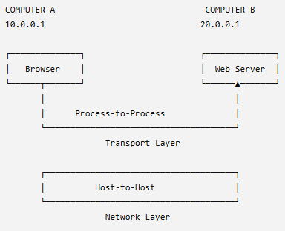
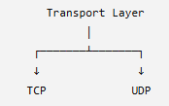
Host to Host vs Process-to-Process
Layer | Type of Delivery | Main Identification
Network Layer | Host-to-Host | IP Address
Transport Layer | Process-to-Process | Port Number
The 2 important protocol in Transport Layer are:

Slide 8
What are the main responsibilities of Transport Layer
Function | Simple Meaning
Process-to-Process Delivery | Delivers data to the correct application
Addressing using Port Numbers | Identifies sending and receiving processes
Segmentation | Helps handle application data in suitable units for transport
Multiplexing / Demultiplexing | Allows many applications to use network communication
Connection Management | TCP can establish and release connections
Flow Control | Prevents a fast sender from overwhelming a slow receiver
Reliability | TCP provides mechanisms for reliable delivery
IP Address tells WHERE the computer is.
Port Number tells WHICH application should receive the data.

Slide 9
Port Numbers and Process Identification
Why do we need Port Numbers?
Suppose your laptop has IP address:
192.168.1.10
At the same time, you may be using several network applications:
Laptop: 192.168.1.10
├── Web Browser
├── Email Application
├── Video Call
└── Some other network application
Now suppose some data comes from the Internet and reaches: 192.168.1.10
The IP address has done its job. It brought the data to the correct laptop.
But the operating system still has a question:
Which application should receive this data?
Should it go to the browser? Email application? Some other program?
Therefore, we need another number.
That number is the Port Number.

Slide 10
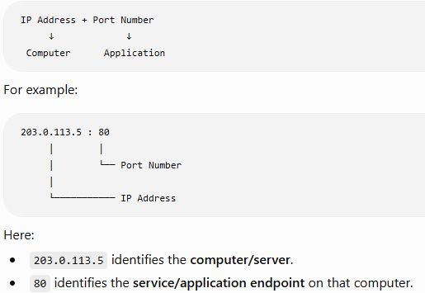
Port Numbers and Process Identification
A Port Number is a numerical identifier used by the Transport Layer to identify a specific application/process on a device.
Source Port and Destination Port
When two applications communicate, we normally have two port numbers:
CLIENT SERVER
192.168.1.10 203.0.113.5
Source Port No: 50000
Destination Port No: 80
Source Port
Source Port identifies the sending application/process.
Destination Port
Destination Port identifies the receiving application/process.

Slide 11
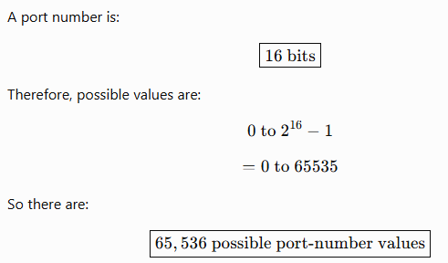
How large is a Port Number?

Slide 12
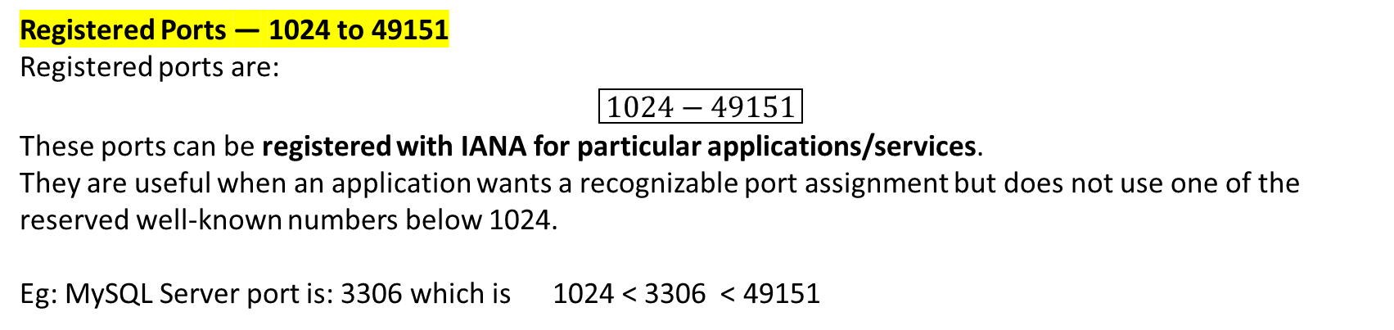
Port Number Categories
Well-Known Ports — 0 to 1023
Port numbers are divided into three important ranges
Service/Protocol | Common Port
FTP Data | 20
FTP Control | 21
SSH | 22
DNS | 53
HTTP | 80
HTTPS | 443
Category | Range | Simple Meaning
Well-Known Ports | 0–1023 | Used by standard/common services
Registered Ports | 1024–49151 | Assigned/registered for applications/services
Dynamic / Private Ports | 49152–65535 | Commonly used temporarily by clients
Registered Ports — 1024 to 49151
Registered ports are:
$$\boxed{1024−49151}$$
These ports can be registered with IANA for particular applications/services.
They are useful when an application wants a recognizable port assignment but does not use one of the reserved well-known numbers below 1024.
Eg: MySQL Server port is: 3306 which is 1024 < 3306 < 49151

Slide 13
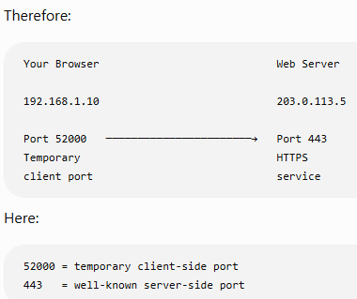
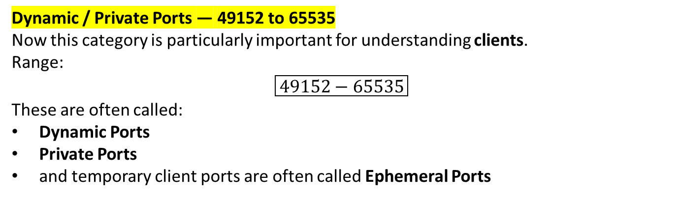
Port Number Categories
Dynamic / Private Ports — 49152 to 65535
Now this category is particularly important for understanding clients.
Range:
$$\boxed{49152−65535}$$
These are often called:
Dynamic Ports
Private Ports
and temporary client ports are often called Ephemeral Ports
Suppose you open your browser and connect to: Web Server → Port 443
The browser also needs a local port for its side of the communication.
The operating system may temporarily assign something like: 52000
After that communication is finished, that temporary port is no longer permanently tied to that browser-server session and can eventually be reused.

Slide 14
Server Port vs Client Port
Client Side | Server Side
Often uses a temporary/ephemeral port | Commonly listens on a known/configured service port
Example: 52000 | Example: HTTP 80
Chosen for a client communication | Service waits for incoming requests
May change between connections | Usually kept predictable for the service

Slide 15
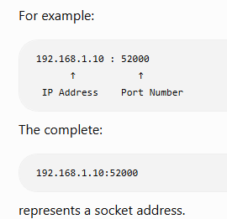
What is a Socket Address?
A Socket Address is the combination of an IP address and a port number used to identify one communication endpoint in a network.
Suppose I only tell you: 192.168.1.10
You know which computer, but not which application/process endpoint.
If I only tell you: 52000
you know a port number, but not which computer it belongs to.
Combine them: 192.168.1.10 : 52000
Now we know both:
192.168.1.10 → Which Host?
52000 → Which Port/Endpoint?
Therefore:
IP alone is incomplete for process-to-process communication. Port alone is also incomplete. Together they form a Socket Address

Slide 16
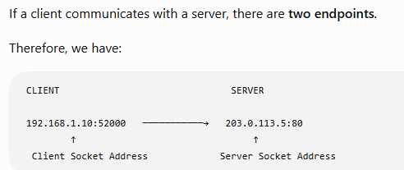
What is a Socket Address?
What exactly is a Socket?
Communication requires TWO Socket Addresses
Socket and Socket Address are related, but they are not exactly the same thing.
Socket Address
IP Address + Port Number that identifies an endpoint.
Example:
192.168.1.10:52000
Socket
A socket is a software communication endpoint that an application uses to send and receive data through the network.
In simple terms:
A socket acts like a communication door between an application and the network.
The communication takes place between these two endpoints.

Slide 17
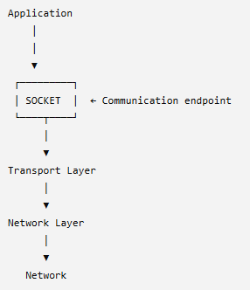
What is a Socket Address?
What exactly is a Socket?
Socket and Socket Address are related, but they are not exactly the same thing.
Socket Address
IP Address + Port Number that identifies an endpoint.
Example:
192.168.1.10:52000
Socket
A socket is a software communication endpoint that an application uses to send and receive data through the network.
In simple terms:
A socket acts like a communication door between an application and the network.
So the application doesn't directly put data onto the physical network.
It communicates through a socket provided by the operating system/networking API.
Both client & server has its own Sockets.

Slide 18
Socket Address vs IP Address vs Port Number vs Socket
Term | Meaning | Example
IP Address | Identifies a host/interface in the network | 192.168.1.10
Port Number | Identifies a transport-layer application/process endpoint | 52000
Socket Address | IP Address + Port Number | 192.168.1.10:52000
Socket | Software communication endpoint used by an application | Client/Server socket
In TCP, a connection is commonly identified using the combination of:
Source IP
Source Port
Destination IP
Destination Port

Slide 19
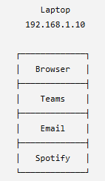
Multiplexing & Demultiplexing at the Transport Layer
The main question is:
A computer can run Chrome, Teams, email, Spotify, etc. at the same time. All of them use the same network connection. So how does the Transport Layer handle data from all these applications and deliver incoming data back to the correct application?
The answer is: Multiplexing & Demultiplexing.
Suppose one laptop has:
IP Address = 192.168.1.10 and four applications are communicating over the network:
All four applications need to send data.
But the laptop does not have a completely separate Internet connection for every application.
Instead, the Transport Layer has to handle data from multiple application processes.

Slide 20
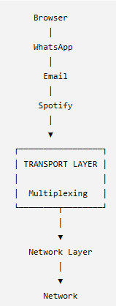
Multiplexing & Demultiplexing at the Transport Layer
Multiplexing is the process in which the Transport Layer collects data from multiple application processes/sockets and prepares it for transmission through the network.
In very simple words:
Many applications → One Transport/Network system
The Transport Layer is receiving data from many different applications.
It must keep their communications distinguishable.
This is where port numbers become extremely important.

Slide 21
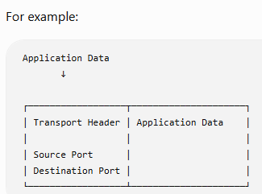
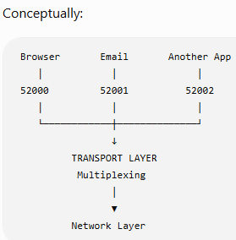
How does Multiplexing Works?
When the Transport Layer handles their data, the appropriate transport header carries port information.
Suppose three applications are communicating:
Application | Local Port
Browser | 52000
Email App | 52001
Another App | 52002
Therefore, data from different applications does not simply become indistinguishable.
The port information helps identify the relevant communication endpoints.

Slide 22
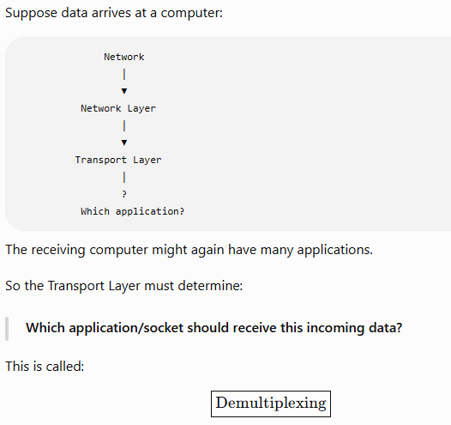
Now what happens at the Receiver?
Demultiplexing is the process in which the receiving Transport Layer examines transport information, especially port information, and delivers incoming data to the appropriate socket/application process.

Slide 23
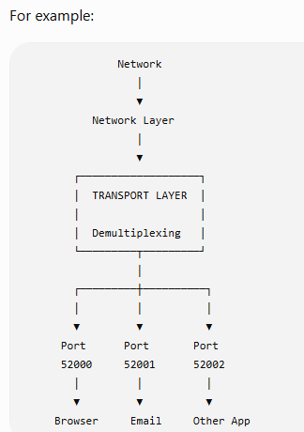
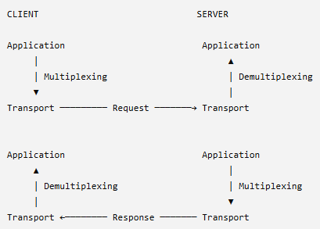
Demultiplexing
So:
Multiplexing happens when handling data from multiple applications for sending.
Demultiplexing happens when delivering received data to the appropriate application/socket.
Incoming data → Correct application

Slide 24
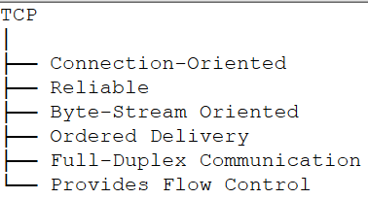
Introduction to TCP & TCP Service Model
TCP stands for: Transmission Control Protocol
TCP is a Transport Layer protocol used to provide reliable, connection-oriented communication between applications running on different hosts.
IP helps packets travel from one host to another.
But IP itself does not guarantee that:
every packet will arrive,
packets will arrive in the correct order,
duplicate delivery will never occur,
a lost packet will automatically be retransmitted by IP.
Why do we need TCP?
Application
↓
Transport Layer
↓
Network Layer
↓
IP
↓
Network
For applications that require reliable delivery, the Transport Layer needs mechanisms to deal with such problems.
TCP provides those mechanisms.

Slide 25
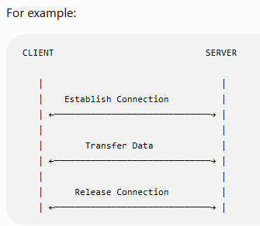
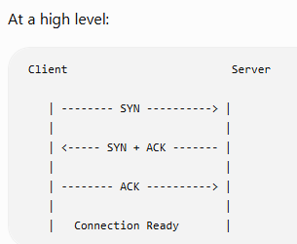
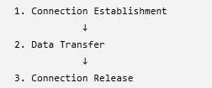
TCP is Connection-Oriented
Connection-oriented means TCP establishes a logical connection between the two endpoints before normal application data transfer begins.
How does TCP establish the connection?
So TCP communication broadly has three phases:
Three-Way Handshake

Slide 26
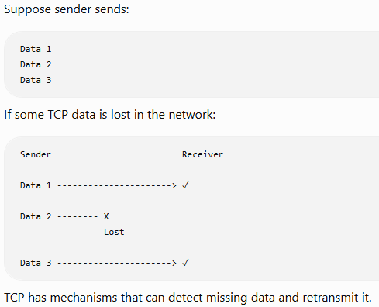
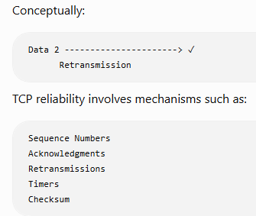
TCP provides Reliable Delivery
Reliable delivery means TCP uses mechanisms to make sure the application receives the intended data correctly and in order, or detects/recover from losses as appropriate rather than simply ignoring them.

Slide 27
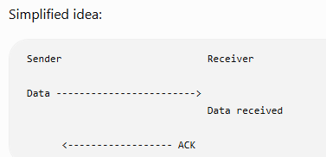
Acknowledgment — Basic Idea
Suppose the sender transmits some data.
The receiver can send an acknowledgment indicating what data it has successfully received / what byte it expects next.
Acknowledgment
In simple terms, it provides feedback related to successful receipt.

Slide 28
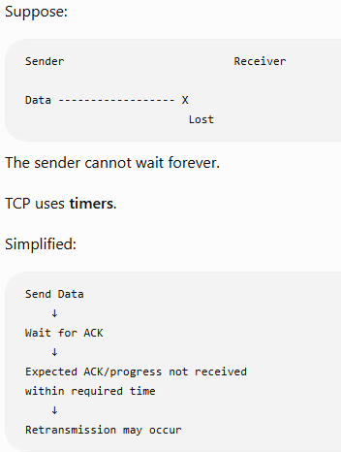
What if TCP doesn't receive the required acknowledgment?
We will study this TCP Timer Management in detail later.

Slide 29
TCP provides Ordered Delivery
Suppose the application data logically belongs in this order: A → B → C → D
Due to network behavior, pieces of TCP data may arrive in a different order.
Conceptually:
Expected: A B C D
Arrival: A C B D
TCP uses sequence numbers to keep track of the byte stream.
It can therefore provide the application with the data in the proper order.
So the application should see:
A B C D
rather than simply being handed data in whatever network arrival order occurred.

Slide 30
TCP is Byte-Stream Oriented
TCP provides applications with a byte-stream service.
Suppose an application writes:
HELLO STUDENTS
At the Transport Layer, TCP views application data as a stream of bytes.
Conceptually:
H E L L O S T U D E N T S
↓ ↓ ↓ ↓ ↓ ↓ ↓ ↓ ↓ ↓ ↓ ↓ ↓ ↓
Byte stream
TCP is Full Duplex
Both sides can send and receive data simultaneously over the TCP connection.

Slide 31
TCP provides Flow Control
Suppose:
Sender capacity = 1000 units/sec
Receiver capacity = 300 units/sec
If the sender keeps pushing data faster than the receiver can accept/process/buffer it, the receiver's buffer could become overwhelmed.
TCP therefore provides flow control.
Flow control prevents a fast sender from overwhelming a slower receiver.
The receiver communicates information about how much data it is currently prepared to accept.

Slide 32
TCP also performs Error Detection
TCP has a checksum field in its header.
Its purpose is to help detect corruption affecting the TCP segment.
Conceptually:
Sender
│
Calculate checksum
│
▼
Send TCP Segment
│
▼
Receiver
│
Verify checksum
If corruption is detected, TCP does not simply deliver corrupted application data as valid data.

Slide 33
TCP Service Model
What is a Service Model?
A service model describes the kind of communication service a protocol provides to the application above it.
So when we say:
TCP Service Model
we are basically asking:
What type of communication service does TCP provide to applications?
TCP Service | Meaning
Connection-Oriented | Establishes connection state before normal data transfer
Reliable | Uses ACKs, sequence numbers, retransmissions, timers, etc. to provide reliable delivery
Ordered Delivery | Application receives bytes in correct order
Byte-Stream Service | Treats application data as a continuous sequence of bytes
Full Duplex | Both endpoints can send and receive
Flow Control | Prevents sender from overwhelming receiver
Error Detection | Uses checksum to detect corruption
Process-to-Process Communication | Uses ports/sockets to communicate between application processes

Slide 34
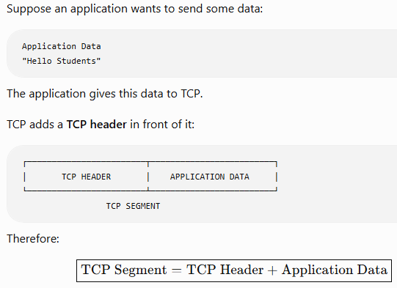
What is a TCP Segment?
Why does TCP need such a large Header?
Compare what TCP has to do.
TCP provides:
process-to-process communication,
reliable delivery,
ordered delivery,
connection establishment/release,
acknowledgments,
flow control,
error detection,
and other connection-management functions.
Therefore, TCP needs several pieces of control information.
The header contains the control information TCP needs to manage communication.

Slide 35
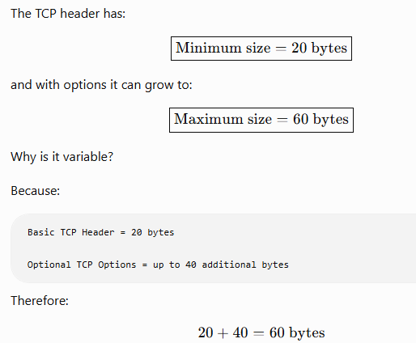
TCP Header Size

Slide 36
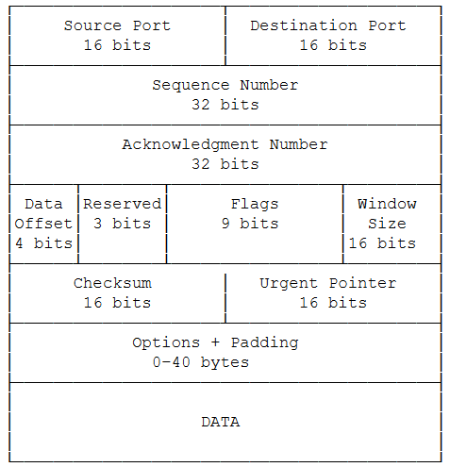
TCP Header

Slide 37
Source Port — 16 bits
What does it contain?
It contains the port number of the sending side.
Example:
Client Browser
IP = 192.168.1.10
Port = 52000
When the client sends a TCP segment:
Destination Port — 16 bits
Destination Port — 16 bits
This contains the port number of the receiving side.
Example:
Client Browser Web Server
52000 ------------------> 80
So:
Source Port = 52000
Destination Port = 80

Slide 38
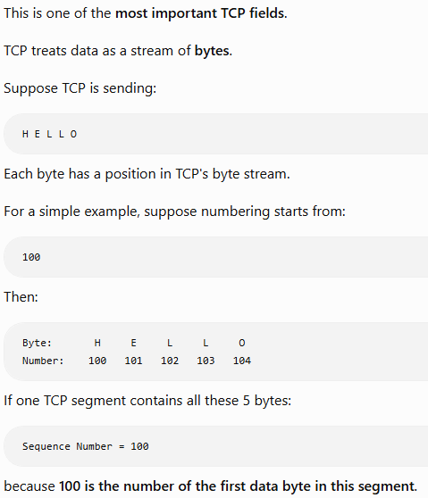
Sequence Number — 32 bits

Slide 39
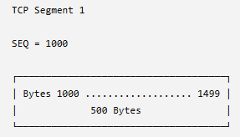
Sequence Number — 32 bits
Another example
Suppose:
Sequence Number = 1000
Data Size = 500 bytes
The segment contains bytes:
1000 ------------------------- 1499
Therefore, the next byte is: 1500
The next data segment could therefore start with: Sequence Number = 1500
Why do we need Sequence Numbers?
They help TCP:
put data in the correct order,
identify missing data,
handle retransmitted/duplicate data,
provide reliable delivery.
Sequence Number = Number/position of the first data byte carried by the segment.

Slide 40
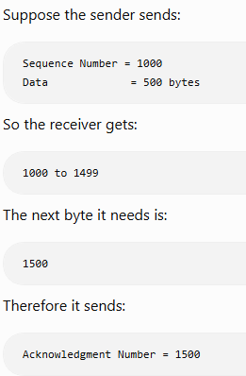
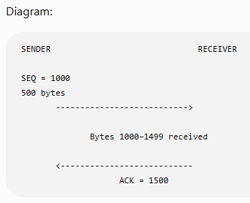
Acknowledgment Number — 32 bits
The ACK number tells the sender: Which byte does the receiver expect next?
ACK = 1500 means:
"I have received everything continuously up to byte 1499. Send me byte 1500 next."
It does not mean:
"I received byte 1500."

Slide 41
Acknowledgment Number — 32 bits
TCP acknowledgments are normally cumulative. This means one ACK can acknowledge a continuous range of bytes.
Suppose sender sends:
Segment 1:
SEQ = 1000
Data = 500 bytes
Segment 2:
SEQ = 1500
Data = 500 bytes
Segment 3:
SEQ = 2000
Data = 500 bytes
Meaning:
"Everything continuously before 2500 has been received; send me byte 2500 next."
So one ACK can cover many bytes/segments.
If the receiver has successfully received all continuous bytes from: 1000 through 2499
it can send: ACK = 2500
Sequence Number and ACK Number exist on BOTH sides i.e., on client side as well as on server side.

Slide 42
Acknowledgment Number — 32 bits
Sequence Number | Acknowledgment Number
32 bits | 32 bits
Tells position of data being sent | Tells next byte expected from other side
Related to sender's byte stream | Related to receiver's expectation from opposite byte stream
Helps ordering and tracking | Confirms continuous receipt/progress
Example: SEQ = 1000 | Example: ACK = 1500

Slide 43
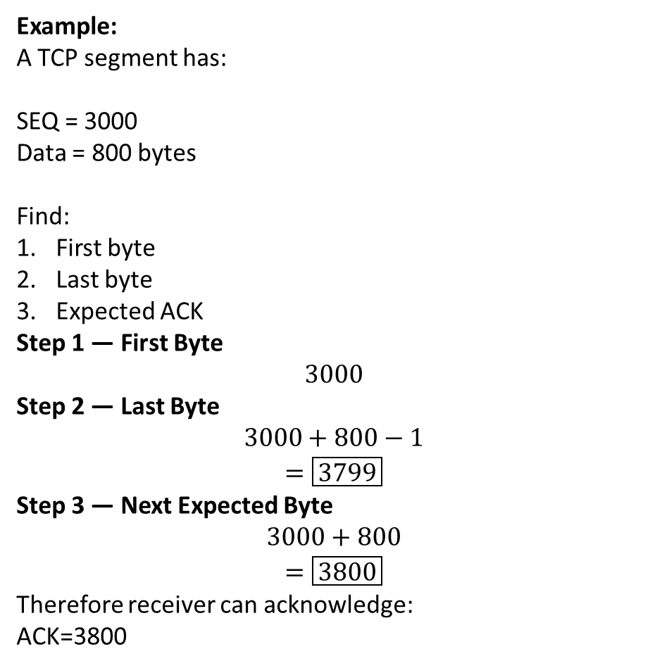
Acknowledgment Number — 32 bits
Example:
A TCP segment has:
SEQ = 3000
Data = 800 bytes
Find:
First byte
Last byte
Expected ACK
Step 1 — First Byte
$$3000$$
Step 2 — Last Byte
$$3000+800−1$$
$$=\boxed{3799}$$
Step 3 — Next Expected Byte
$$3000+800$$
$$=\boxed{3800}$$
Therefore receiver can acknowledge:
ACK=3800​

Slide 44
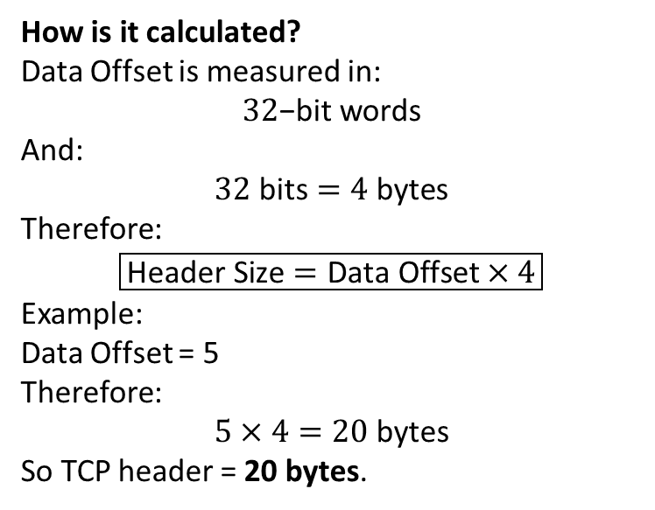
Data Offset — 4 bits
The name Data Offset sounds difficult, but the idea is simple.
It tells the receiver: Where does the actual TCP data start?
Why is this needed?
Because TCP header size is not always the same.
It can be:
20 bytes
24 bytes
28 bytes
32 bytes
...
60 bytes
depending on whether TCP options are present.
So the receiver needs to know:
Where does Header end?
↓
Where does Data start?
How is it calculated?
Data Offset is measured in:
$$32\text{−bit words}$$
And:
$$32\text{ bits}=4\text{ bytes}$$
Therefore:
$$\boxed{\text{Header Size}=\text{Data Offset}×4}$$
Example:
Data Offset = 5
Therefore:
$$5×4=20\text{ bytes}$$
So TCP header = 20 bytes.
Data Offset tells TCP header length and therefore where TCP data begins.

Slide 45
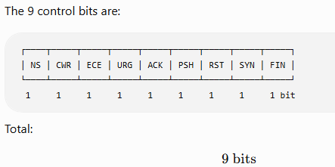
Reserved — 3 bits
These are bits kept reserved in the modern TCP header layout.
For basic understanding:
Reserved bits are kept for protocol use/future extension and are normally set to 0 unless defined otherwise by the standard.
Flags / Control Bits — 9 bits
TCP has control bits that tell the receiver what kind of control action/information is associated with the segment

Slide 46


SYN — Synchronize
SYN is mainly used to start a TCP connection and synchronize sequence-number state.
During connection establishment:
FIN — Finish
FIN is used when one side wants to finish sending data and close its side of the TCP connection gracefully.
So for now: SYN = Used while establishing a TCP connection
FIN = Finish / close gracefully
ACK — Acknowledgment
ACK tells us that the: Acknowledgment Number field is valid.
Example:
ACK flag = 1
Acknowledgment Number = 1500
means the acknowledgment information should be considered.
Remember
ACK = Acknowledgment field is valid

Slide 47
RST — Reset
RST is used to reset a TCP connection immediately.
It is different from FIN.
FIN → Normal/graceful closing
RST → Immediate/abrupt reset
For example, a host may send RST when a TCP connection request reaches a port where no service is listening.
RST = Reset the connection
URG — Urgent
URG tells TCP that:
Urgent Pointer
is meaningful.
It belongs to TCP's urgent-data mechanism.
URG = Urgent Pointer is valid
ECE — ECN Echo
ECE is related to Explicit Congestion Notification (ECN).
Remember the congestion from Network Layer.
ECN allows congestion to be signaled without relying only on packet drops.
ECE = Used for ECN/congestion notification information
PSH — Push
PSH tells the receiving TCP:
Make the received data available to the application promptly.
Simple idea:
Data arrives
↓
Don't unnecessarily keep waiting
↓
Push it toward the application
PSH = Push data to application promptly

Slide 48
CWR — Congestion Window Reduced
CWR is also related to ECN.
It is used to indicate that the sender has reacted to congestion notification by reducing its congestion window.
Simply:
CWR = Sender indicates it reacted to ECN congestion information

Slide 49
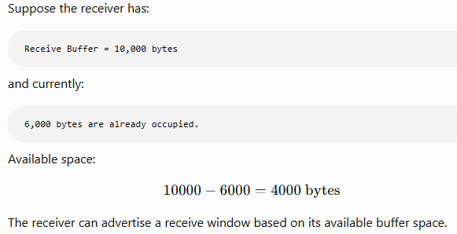
Window Size — 16 bits
This field is used for : $\boxed{\text{Flow Control}}$
Remember:
Flow Control prevents a fast sender from overwhelming a slow receiver.
Window Size = How much receive-window space the receiver is advertising
The sender uses the advertised receive window to help decide how much unacknowledged data it can have outstanding for flow-control purposes.

Slide 50
Checksum — 16 bits
Checksum is used for: Error Detection​
Urgent Pointer — 16 bits
This field works with:
URG flag
If:
URG = 1
then the Urgent Pointer field is meaningful.
It is used by TCP's urgent-data mechanism to indicate the urgent-data boundary relative to the sequence number.
The main relationship is:
URG Flag
+
Urgent Pointer
↓
TCP Urgent Data Mechanism
Remember
Urgent Pointer is used with URG for urgent-data handling.

Slide 51
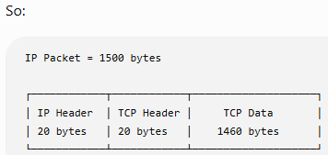
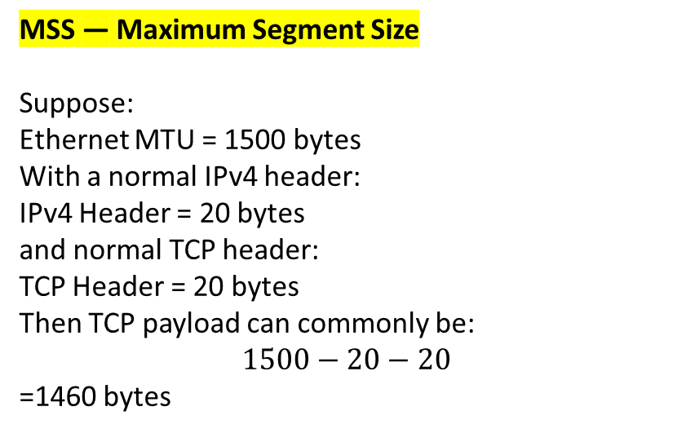
Options — 0 to 40 bytes
TCP has a basic header of: 20 bytes
But sometimes TCP needs extra information.
That extra information can be placed in: Options
Common TCP options include:
MSS — Maximum Segment Size
Suppose:
Ethernet MTU = 1500 bytes
With a normal IPv4 header:
IPv4 Header = 20 bytes
and normal TCP header:
TCP Header = 20 bytes
Then TCP payload can commonly be:
$$1500−20−20$$
=1460 bytes​
Option | Simple Purpose
MSS | Tells maximum TCP data size the host is willing to receive in a segment
Window Scale | Allows TCP to use larger receive windows
SACK | Helps report which blocks of data have been received
Timestamp | Helps with timing/RTT-related TCP operation

Slide 52
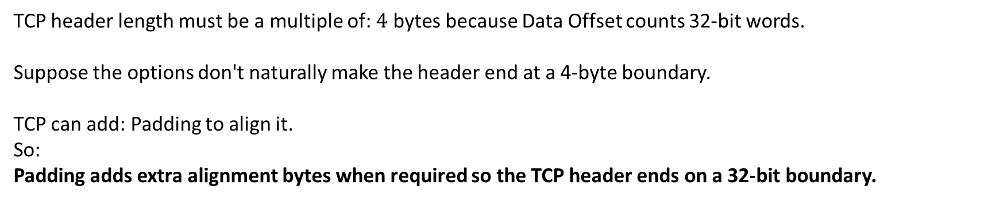
Padding — Variable
TCP header length must be a multiple of: $4\text{ bytes}$ because Data Offset counts 32-bit words.
Suppose the options don't naturally make the header end at a 4-byte boundary.
TCP can add: Padding to align it.
So:
Padding adds extra alignment bytes when required so the TCP header ends on a 32-bit boundary.
Data — Variable Size
Finally, after the TCP header comes the actual data from the application.
For example:
HTTP Data
File Data
Email-related application data
etc.

Slide 53
Field | Size | Simple Purpose
Source Port | 16 bits | Port of sender
Destination Port | 16 bits | Port of receiver
Sequence Number | 32 bits | Position of first data byte
Acknowledgment Number | 32 bits | Next byte expected
Data Offset | 4 bits | TCP header length
Reserved | 3 bits | Reserved
Flags | 9 bits | Control TCP operation
Window Size | 16 bits | Flow control
Checksum | 16 bits | Error detection
Urgent Pointer | 16 bits | Used with URG
Options | 0–40 bytes | Extra TCP features
Padding | Variable | Makes header align to 32-bit boundary
Data | Variable | Actual application data

Slide 54
TCP Connection Establishment: Three-Way Handshake
Why does TCP need a Handshake?
We already studied that TCP is:
Connection-oriented
This means TCP does not normally start sending application data without first setting up connection state between the two sides.
Before normal data transfer, both sides need to know that the other side is ready and synchronize important connection information, especially their initial sequence numbers.
The process used to establish the TCP connection is called: Three-Way Handshake​

Slide 55
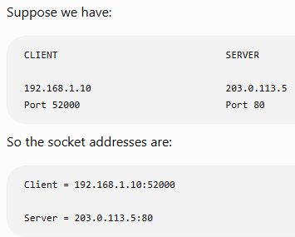
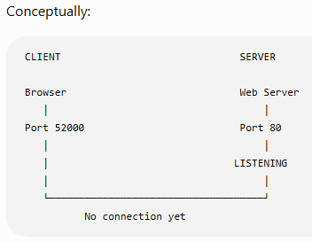
Client and Server before the Handshake
The server is already waiting/listening for TCP connection requests on its service port.

Slide 56
Three-Way Handshaking
Initial Sequence Number — ISN
Each side chooses an Initial Sequence Number (ISN) for the connection.
Suppose:
Client ISN = 1000
Server ISN = 5000
So:
CLIENT SERVER
ISN = 1000 ISN = 5000

Slide 57
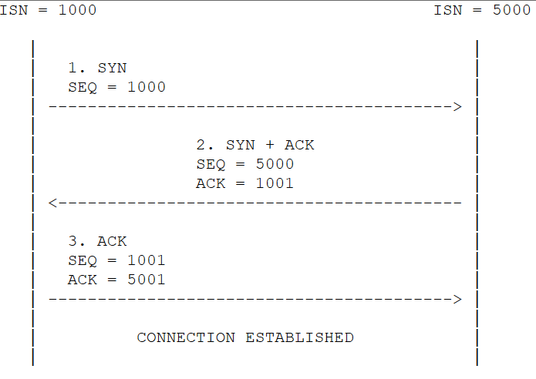
Three-Way Handshaking
Step 1: Client Sends SYN
The client wants to start a TCP connection with the server.
So the client sends:
SYN = 1
SEQ = 1000
What is SYN doing?
SYN stands for Synchronize.
The client is basically saying:
"I want to establish a TCP connection, and my initial sequence number is 1000.“
OR
TCP SYN is mainly related to synchronizing the sequence-number state used for the connection.
So:
SYN = Connection establishment request
SEQ = Client's Initial Sequence Number

Slide 58

Three-Way Handshaking
SYN consumes one Sequence Number
Even though the SYN does not need to carry normal application data, it consumes one sequence number in TCP's sequence space.
So if:
SYN SEQ = 1000
the next sequence number becomes:
$$1000+1=1001$$
Therefore:
Client SYN = SEQ 1000
Client next SEQ = 1001

Slide 59
Three-Way Handshaking
Step 2 — Server sends SYN + ACK
The server receives:
SYN
SEQ = 1000
Now the server has two things to do.
It needs to:
Acknowledge the client's SYN
and
Send its own SYN
TCP can do both in one segment.
Therefore:
SYN = 1
ACK = 1
This is why the second step is called:
SYN + ACK​

Slide 60
Three-Way Handshaking
What ACK should the Server send?
Client sent:
SEQ = 1000
SYN consumes one sequence number.
Therefore the server expects:
1001
So:
ACK=1001​
So the server is basically saying:
"I received your SYN with sequence number 1000. Now I expect 1001 from you."

Slide 61
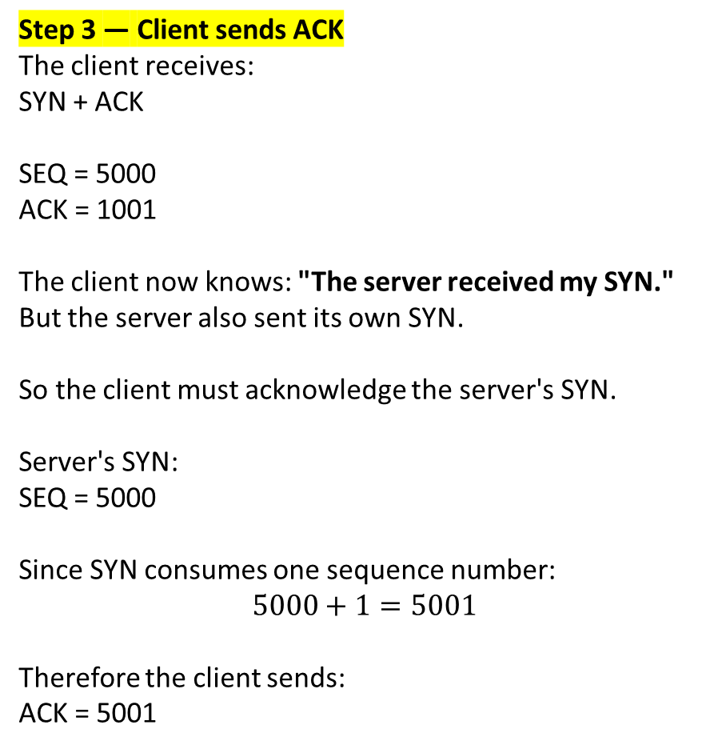
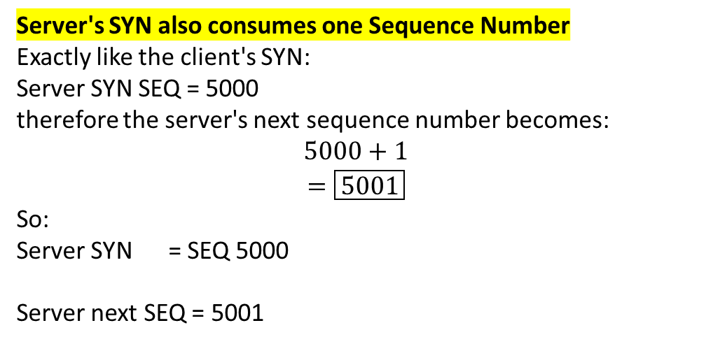
So the server is communicating two things at once:
ACK = 1001
↓
"I received your SYN."
SEQ = 5000 + SYN
↓
"This is my starting sequence number."
Step 3 — Client sends ACK
The client receives:
SYN + ACK
SEQ = 5000
ACK = 1001
The client now knows: "The server received my SYN."
But the server also sent its own SYN.
So the client must acknowledge the server's SYN.
Server's SYN:
SEQ = 5000
Since SYN consumes one sequence number:
$$5000+1=5001$$
Therefore the client sends:
ACK = 5001
Server's SYN also consumes one Sequence Number
Exactly like the client's SYN:
Server SYN SEQ = 5000
therefore the server's next sequence number becomes:
$$5000+1$$
$$=\boxed{5001}$$
So:
Server SYN = SEQ 5000
Server next SEQ = 5001

Slide 62
Three-Way Handshaking
TCP Three-Way Handshake is the process used to establish a TCP connection between two endpoints. It uses three steps: SYN, SYN+ACK, and ACK. During this process, both sides exchange and acknowledge their initial sequence numbers before normal data communication begins.

Slide 63
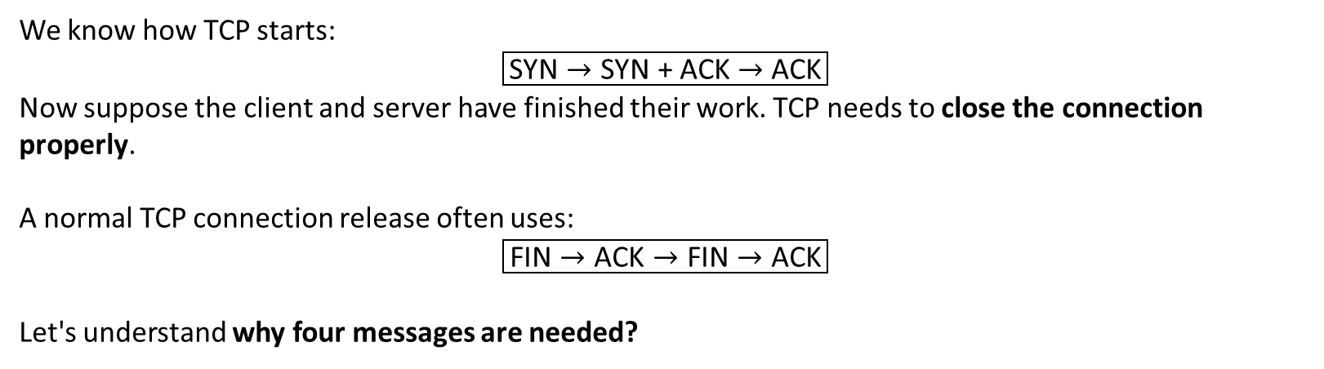
TCP Connection Release
We know how TCP starts:
$$\boxed{\text{SYN}→\text{SYN + ACK}→\text{ACK}}$$
Now suppose the client and server have finished their work. TCP needs to close the connection properly.
A normal TCP connection release often uses:
$$\boxed{\text{FIN}→\text{ACK}→\text{FIN}→\text{ACK}}$$
Let's understand why four messages are needed?
After some time, the client has no more data to send.
It needs a way to tell the server: "I have finished sending data."
TCP uses the FIN flag for this.
FIN = Finish
But there is an important point:
One side finishing its data does not automatically mean the other side has also finished sending its data.

Slide 64
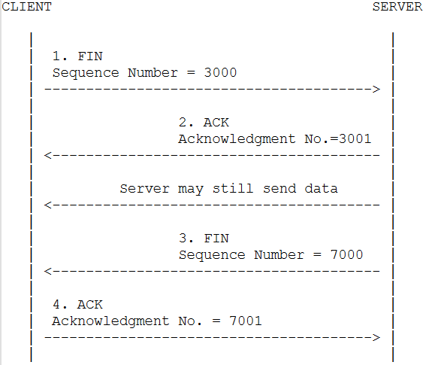
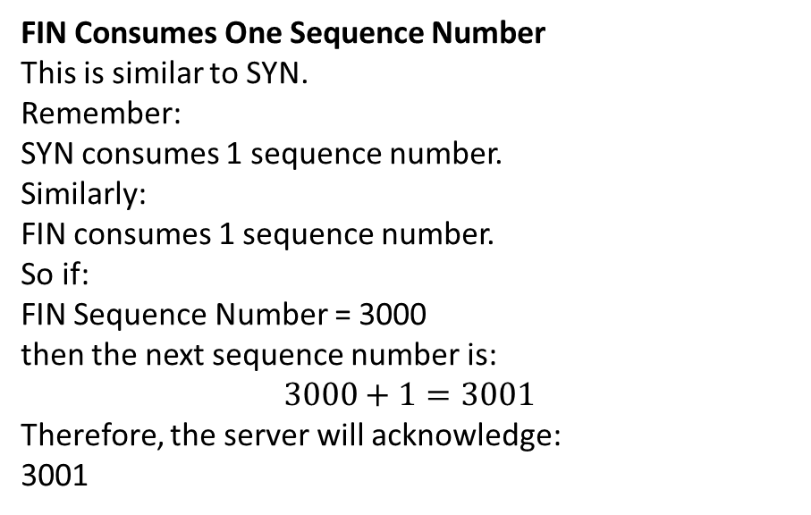
TCP Connection Release
Suppose:
Client Sequence Number = 3000
Server Sequence Number = 7000
Step 1 — Client Sends FIN
Suppose the client has finished sending data.
It sends a TCP segment with:
FIN Flag = 1
Sequence Number = 3000
FIN Consumes One Sequence Number
This is similar to SYN.
Remember:
SYN consumes 1 sequence number.
Similarly:
FIN consumes 1 sequence number.
So if:
FIN Sequence Number = 3000
then the next sequence number is:
$$3000+1=3001$$
Therefore, the server will acknowledge:
3001​

Slide 65
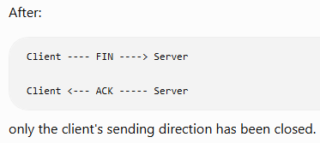
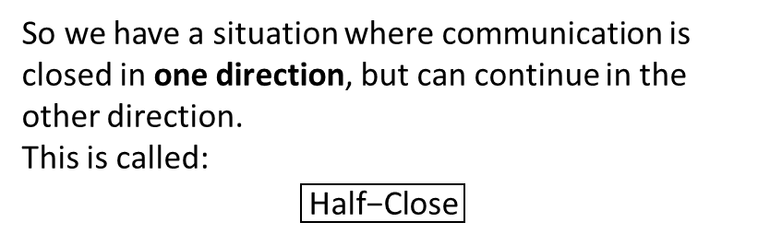

TCP Connection Release
Step 3 — Server Sends FIN
Eventually, the server also finishes sending its data.
Now it sends:
FIN Flag = 1
Sequence Number = 7000
Step 2 — Server Sends ACK
The server receives the client's FIN.
It needs to acknowledge it.
So the server sends:
ACK Flag = 1
Acknowledgment Number = 3001
Again, FIN Consumes One Sequence Number
Server sends:
FIN Sequence Number = 7000
Therefore:
$$7000+1=7001$$
The client should acknowledge:
7001​
Step 4 — Client Sends Final ACK
Client receives the server's FIN.
It responds:
ACK Flag = 1
Acknowledgment Number = 7001
So we have a situation where communication is closed in one direction, but can continue in the other direction.
This is called:
$$\boxed{\text{Half−Close}}$$
Now both sending directions have been closed.

Slide 66

TCP Flow Control
What Problem Does Flow Control Solve?
What if the Sender keeps sending?
Suppose the receiver has a buffer of: 10,000 bytes
Initially, buffer -> Empty
Now, 6000 bytes are waiting in the buffer.
Available space: 10000 – 6000 = 4000
If the sender blindly sends another 10,000 bytes, the receiver may not have enough buffer space.
So the receiver needs a way to tell the sender:
“This is how much receive-window space I currently have available.
This is the basic idea of TCP Flow Control.
Hence, Flow control mainly protects the:
Receiver
TCP Flow Control is a mechanism that prevents a sender from sending more outstanding data than the receiver can currently accept in its receive buffer.

Slide 67

How does the Receiver tell the Sender?
Receive Window keeps changing
Suppose total buffer capacity is 5000 bytes.
Situation | Data Waiting in Buffer | Available Space
Initially | 0 | 5000
Data arrives | 2000 | 3000
More data arrives | 4000 | 1000
Application reads 3000 | 1000 | 4000
Application reads remaining data | 0 | 5000
The receiver advertises its available receive window through TCP's Window field.
This is called the: Receiver Window
What is Zero Window?
My receive window currently has no room for more normal data. Stop sending additional data for now.
So the receiver can keep updating the sender about its available window.
This is why TCP flow control is dynamic.

Slide 68

Why does TCP need a Sliding Window?
The sender sends some data and then waits for its acknowledgment before sending more.
This wastes time, especially when the network delay is large.
For example, suppose:
Sender can send data very quickly.
Receiver is far away.
ACK takes time to return.
TCP can do better.
It can allow multiple bytes/segments to be in transit before waiting for acknowledgments, as long as the allowed window is not exceeded.

Slide 69


TCP Sliding Window
TCP Sliding Window allows the sender to have multiple bytes of data outstanding before receiving their acknowledgments, while staying within the allowed window.
Outstanding data means: Data that has been sent but has not yet been acknowledged.
TCP Window is based on BYTES
This is the major difference from the way we studied sliding-window protocols in the Data Link Layer.
In DLL, we commonly talked about:
Frame 0
Frame 1
Frame 2
Frame 3
For example:
Need for Window?
Window allows the sender to send multiple bytes of data without waiting after every small transmission, but it also puts a limit on how much data can be sent before the window must move or change.
But TCP works with a byte stream.
Therefore, TCP's window is based on:
$$\boxed{\text{Bytes}}$$
For example:
Receive Window = 4000 bytes

Slide 70

TCP Window works with BYTES
This is important. TCP treats application data as a stream of bytes.
Suppose we have:
Byte numbers:
1000 1001 1002 1003 1004 1005 ...
Therefore TCP's window is also described using byte sequence numbers.
Let's say:
Next byte = 1000
Window Size = 4000 bytes
Then the window covers: 1000 to 4999
because: 1000 + 4000 – 1 = 4999
This means the sender has a 4000-byte range available according to this window.

Slide 71

How will these 4000 bytes actually be sent?
The sender does not have to put all 4000 bytes into one TCP segment.
For easy understanding, suppose each TCP segment carries:
1000 bytes.
Then the sender can divide the data like this:
TCP Segment | Sequence Number | Data Bytes
Segment 1 | 1000 | 1000–1999
Segment 2 | 2000 | 2000–2999
Segment 3 | 3000 | 3000–3999
Segment 4 | 4000 | 4000–4999
Now the sender can send these segments without waiting for an ACK after every single segment.

Slide 72

Sending the Data
The communication may look like:
Now the sender has used the complete 4000-byte window.
At this point, it cannot simply keep sending unlimited new data.
It needs ACKs and updated window information to know that it can move forward.

Slide 73

Now ACK comes into the picture
Suppose the receiver successfully receives:
Segment 1 → Bytes 1000–1999
Segment 2 → Bytes 2000–2999
The receiver has now received everything continuously from: 1000 to 2999
What byte does it want next?
3000
Therefore it sends:
$$\boxed{\text{Acknowledgment Number}=3000}$$
Remember the simple meaning:
ACK 3000 means: "I have received everything continuously before 3000. Send/continue from byte 3000."

Slide 74

Now what happens to the Window?
This is the most important part of the topic.
Initially our window was:
Now bytes: 1000–2999 have been acknowledged.
So we no longer need to keep those bytes at the beginning of the window.
The window can move forward.
Suppose the receiver continues to advertise a 4000-byte window.
Then:
Acknowledgment Number = 3000
Window Size = 4000
New window: 3000 to 6999
because: 3000 + 4000 – 1 = 6999

Slide 75


The window was: 1000–4999
and then became: 3000–6999
So the window moved forward.
That is why it is called: Sliding Window

Slide 76


But there is one important thing here

Slide 77
So what exactly is sliding?
The actual data is not called the sliding window.
The allowed range of byte sequence numbers moves forward.
In simple words:
As old data is acknowledged, its space is removed from the beginning of the window and new space becomes available at the end.
Data Link Layer | TCP
We commonly worked with frames | TCP works with bytes
Window may be described as number of frames | TCP window is based on byte sequence numbers
We studied GBN and SR as separate protocols | TCP has its own ACK and retransmission mechanisms
Example: Frames 0,1,2,3 | Example: Bytes 1000–4999
TCP uses a byte-based Sliding Window mechanism.

Slide 78


Numerical Example:
That is:
$$1500\text{ bytes}$$
The next byte expected is:
$$6500$$
So:
$$\boxed{ACK=6500}$$
Suppose the receiver again advertises:
Window Size = 3000
Then the new window becomes:
6500 to 9499
Suppose:
Next Byte = 5000
Window Size = 3000 bytes
Find the window range
Solution:
Starting byte:
$$5000$$
Last byte:
$$5000+3000−1$$
$$=7999$$
Therefore:
$$\boxed{5000−7999}$$
Now suppose the receiver receives bytes:
5000–6499

Slide 79

Numerical Example:

Slide 80
Advantages of TCP Sliding Window
Advantage | Simple Meaning
Faster communication | Sender does not wait after every small piece of data
Better use of network | Multiple TCP segments can be travelling at the same time
Flow control | Sender follows the receiver's advertised window
Continuous transmission | ACKs allow the window to keep moving forward
Reliable communication | Sequence numbers and ACKs help track the byte stream

Slide 81
What is TCP Transmission Policy?
When an application gives data to TCP, TCP has to decide: Should I send this data immediately, or should I wait for some more data? This decision is called TCP Transmission Policy.
Definition
TCP Transmission Policy decides when TCP should send the available data to the receiver.
For example, suppose an application gives TCP only 10 bytes of data.
TCP has two choices:
Choice 1:
10 bytes received
↓
Send immediately
Choice 2:
10 bytes received
↓
Wait for some more data
↓
Combine the data
↓
Send a larger TCP segment

Slide 82

Why do we need a Transmission Policy?
Remember that TCP does not send only application data.
Every TCP segment also contains a TCP header.
A basic TCP header is: 20 bytes
Suppose the application gives TCP only: 1 byte of data
If TCP sends it immediately:
Now imagine the application keeps generating 1 byte at a time:
1 byte → TCP Segment
1 byte → TCP Segment
1 byte → TCP Segment
1 byte → TCP Segment
1 byte → TCP Segment
A large number of very small TCP segments will be created.
This is not a good use of the network because a lot of header information is being sent for very little actual data.
TCP is using a 20-byte header to send only 1 byte of data.
TCP Transmission Policy follows flow control to determine how much data the sender can transmit at a time.
The Main Problem — Too Many Small Segments

Slide 83

TCP Timer Management
Why does TCP need a Timer?
We already know that TCP provides reliable communication.
The sender has already sent the data, but it has no idea whether the receiver received it.
The sender cannot wait forever.
Therefore, TCP needs a way to say:
"I will wait for the ACK only for a certain amount of time. If the ACK does not arrive, I will take action."

Slide 84

What is a TCP Timer?
A timer is basically a countdown used by TCP while waiting for an expected event.
The most important timer in this topic is:
RTO — Retransmission Timeout
Retransmission means:
Sending the same data again.
Timeout means:
The allowed waiting time has finished.
Therefore:
RTO is the amount of time TCP waits for an ACK before deciding that retransmission may be required.

Slide 85



How does RTO work?
What if the ACK does not arrive?
Suppose:
RTO = 500 ms
Sender sends a TCP segment.
Immediately, TCP starts its retransmission timer.
Suppose again:
RTO = 500 ms
Timer Continues:
0ms
100ms
200ms
300ms
400ms
500ms
|
RTO Expires
No ACK has Received
Now suppose ACK arrives after: 300 ms
Since:
$$300<500$$
the ACK arrived before the RTO expired.
So retransmission is not needed.

Slide 86

How does TCP decide the RTO value?
This is where the topic becomes interesting.
Why can't we simply say: RTO = 1 second for every connection?
Because network delay is not always the same.
So TCP needs to estimate how long communication is currently taking.
For this, we first need to understand:
RTT — Round-Trip Time

Slide 87


What is RTT? RTT = Round-Trip Time
It means: The time taken for data to travel from the sender to the receiver and for the response/ACK to come back to the sender.
For example:
Data takes approximately: 50 ms to reach the receiver.
ACK takes approximately: 50 ms to return.
Then, in this simplified example:
$$RTT=50+50$$
RTT=100 ms​
RTT Sample
Suppose TCP sends one segment and measures:
Segment sent at: 10:00:00.000
ACK arrives at: 10:00:00.120
Difference:
$$120ms$$
Therefore:
$$RTT_{sample}=120ms$$
This is one measured RTT value.

Slide 88
What is RTT Sample?
RTT Sample is the RTT measured for one particular transmission.
What is Estimated RTT?
Estimated RTT is TCP's calculated average-like value that represents the current expected Round-Trip Time of the connection.
Why can't TCP simply use one RTT sample?
Because network conditions keep changing.
In simple words:
RTT Sample = latest measured RTT
whereas
Estimated RTT = TCP's current estimate based on previous RTT information and the latest RTT sample.
Transmission | Measured RTT
Segment 1 | 100 ms
Segment 2 | 120 ms
Segment 3 | 90 ms
Segment 4 | 130 ms
Now we have a question. Which RTT should TCP use?
100 ms?
120 ms?
90 ms?
130 ms?
TCP cannot simply depend on one measurement because network delay keeps changing.
That is why we need Estimated RTT.

Slide 89



Estimated RTT Formula
OR
Term | Meaning
$RTT_{est}$on the left | New Estimated RTT that we are calculating
$RTT_{est}$on the right | Previous/old Estimated RTT
$$RTT_{sample}$$ | Latest RTT that TCP just measured
$α$(alpha) | Decides how much importance is given to the new RTT sample
$$1−α$$ | Decides how much importance is given to the old Estimated RTT

Slide 90

What exactly is α (Alpha)?
α is a value between 0 and 1 that decides how much importance we give to the latest RTT measurement.
α typically ranges from 0.125 to 0.25.
Suppose:
$$α=0.125$$
Then:
$$1−α=1−0.125=0.875$$
So the formula becomes:
$$New RTT_{est}=0.875\left(Old RTT_{est}\right)+0.125\left(RTT_{sample}\right)$$
Convert these into percentages:
0.875 = 87.5%
0.125 = 12.5%
Therefore TCP is basically saying:
Give 87.5% importance to the previous estimate and 12.5% importance to the latest measurement.

Slide 91



Example:

Slide 92


Explanation:
This is more important than just solving the formula.
Previously TCP thought: Expected RTT ≈ 100 ms
TCP then measured a new RTT: Latest RTT = 120 ms
Instead of immediately changing its estimate to: 120 ms
RTT Sample | Estimated RTT
Actual RTT measured for one transmission | TCP's calculated expected RTT
Represents one latest measurement | Uses previous estimate + latest measurement
Can change a lot from one transmission to another | Changes more smoothly
Written as $RTT_{sample}$ | Written as $RTT_{est}$
It keeps adjusting the expected RTT as new measurements arrive.

Slide 93
Estimated RTT Alone Is Not Enough
Network A
Its RTT measurements are:
98 ms
101 ms
100 ms
102 ms
99 ms
The values stay close to 100 ms.
Network B
60 ms
150 ms
80 ms
180 ms
90 ms
Here the delay changes a lot.
Even if both networks sometimes have a similar average/estimated RTT, their behavior is very different.
So TCP also needs to know: How much is the RTT changing?
This is where RTT Variation comes in.

Slide 94


What is RTT Variation?
RTT Variation is written as:
$$RTT_{var}$$
In simple words:
RTT Variation tells TCP how much the measured RTT is changing around the Estimated RTT.
Why Does TCP Need RTT Variation?
Remember what we are ultimately trying to calculate: RTO — Retransmission Timeout
RTO tells TCP approximately how long it should wait for an ACK before the timeout occurs.
Suppose:
$$Estimated RTT=100ms$$
If network delay is very stable, an ACK will normally arrive somewhere close to that expected time.
But if network delay changes a lot, an ACK may sometimes take much longer.
So TCP needs some extra waiting time.
That extra safety margin depends on RTT variatio

Slide 95


RTT Variation Formula
OR
Term | Meaning
New $RTT_{var}$ | New RTT variation that we are calculating
Old $RTT_{var}$ | Previous RTT variation
$$RTT_{sample}$$ | Latest RTT measured by TCP
$$RTT_{est}$$ | Current Estimated RTT
$$β$$ | Decides how much importance is given to the latest change
$$1−β$$ | Decides how much importance is given to the old variation
| | | Take only the positive difference

Slide 96


What is β (Beta)?
Beta works similarly to the alpha we saw earlier.
It controls how much importance is given to the new change in RTT.
$$β=0.25$$
Therefore:
$$1−β=1−0.25=0.75$$
So the formula becomes:
$$New RTT_{var}=0.75\left(Old RTT_{var}\right)+0.25∣RTT_{sample}−RTT_{est}∣$$
In percentage terms:
75% → old RTT variation
25% → latest difference
So again, TCP does not completely throw away its previous information.
What Does This Part Mean?
The most important part is:
$$∣RTT_{sample}−RTT_{est}∣$$
Suppose:
$$RTT_{sample}=120ms$$
and:
$$RTT_{est}=102.5ms$$
Then:
$$∣120−102.5∣$$
$$=17.5ms$$
What does 17.5 ms tell us?
It tells us:
The latest measured RTT is 17.5 ms away from the Estimated RTT.
Now We Have Two Important Values
Estimated RTT
Tells TCP: Approximately how long is the round trip taking?
RTT Variation
Tells TCP: How much is that round-trip time changing?

Slide 97
What is RTO?
RTO stands for: Retransmission Timeout
Simple definition:
RTO is the time TCP waits for an ACK before the timeout occurs and retransmission may be needed.
Formula: RTO = RTT est ​+ 4 × RTT var​​

Slide 98


Example:
Meaning
Previously TCP estimated: 100 ms
The latest measurement was: 120 ms
So TCP gradually updated its estimate to: 102.5 ms

Slide 99

Example:

Slide 100

Example:

Slide 101

Example:
What Does the Final Answer Actually Mean?
We calculated:
$$\boxed{RTO=270ms}$$
In the simplified context of this numerical, TCP's retransmission timeout is 270 ms.
So conceptually:
TCP sends data
↓
Starts RTO timer
↓
Waits for ACK
↓
RTO = 270 ms
↓
If the timeout occurs without the
required ACK, TCP can retransmit
the unacknowledged data.

Slide 102


Transactional TCP (T/TCP)
What if I Have Only a Very Small Amount of Data?
Suppose a client wants to send some data to a server.
In normal TCP, before normal data communication starts, a connection is established using the 3-way handshake:
This is useful because TCP wants to establish the connection properly before communication.
So for a very short transaction, the connection setup itself adds extra time.
This is the problem Transactional TCP was designed to reduce.

Slide 103
Transactional TCP (T/TCP)
A transaction here means a short request-and-response communication.
Transactional TCP (T/TCP) was designed to make short TCP transactions faster by reducing the delay caused by normal connection setup.
Main Idea of Transactional TCP
Normal TCP conceptually does:
Establish Connection
↓
Send Data
↓
Receive Response
↓
Close Connection
T/TCP tries to reduce the waiting involved at the beginning.
Transactional TCP (T/TCP) is an extension of TCP designed for short data transfers. It reduces connection setup delay by allowing data to be sent earlier during connection establishment.
The key idea is:
Data can be sent in the first packet of the connection.

Slide 104
Transactional TCP (T/TCP)
Normal TCP | Transactional TCP
Uses normal TCP connection establishment | Designed to reduce setup overhead for short transactions
Data normally follows connection setup | Allows data to be sent earlier
Setup delay is less important for long communication | Tries to reduce delay for short communication
General-purpose TCP communication | Designed mainly for short request-response communication

Slide 105
Transactional TCP (T/TCP) - Advantages
Advantage | Simple Explanation
Reduced Connection Setup Time | Reduces the time required before starting data transfer.
Lower Latency | Short requests and responses can be completed faster.
Early Data Transmission | Data can be sent during the connection establishment process.
Good for Short Data Transfers | Useful when only a small amount of data needs to be exchanged.
Suitable for Bursty Traffic | Works well when data is sent in short bursts rather than continuously.

Slide 106


Mobile TCP
Before understanding Mobile TCP, first think about normal TCP.
Suppose a laptop is downloading a file:
Everything is working normally.
Now imagine the laptop/user moves.
For example, you are walking through a university campus with your laptop or phone:
While moving, the device may:
change from one wireless access point/network to another,
temporarily lose wireless connection,
experience more packet loss,
experience changing network delay.
These conditions create problems for normal TCP.

Slide 107

Mobile TCP
What is Handoff / Handover?
Suppose the device is communicating through:
Access Point A
and while moving it changes to:
Access Point B
This change is called a:
Handoff/Handover — the process in which a mobile device changes its connection from one access point/base station to another while moving.
During this process, communication may be interrupted for a short time.

Slide 108
Mobile TCP
What Kind of Problems Does Mobile TCP Address?
Problem | Simple Meaning
Mobility | Device moves from one network/access point to another
Handoff | Device changes its current wireless connection
Temporary Disconnection | Mobile device loses connectivity for a short time
Wireless Packet Loss | Packets may be lost because of wireless conditions
Changing Delay | Network delay can change while the device moves
Wrong Congestion Reaction | Normal TCP may treat some wireless/mobility losses like congestion

Slide 109
Approaches Used for Mobile TCP
Approach | How it Helps
Indirect TCP (I-TCP) | Splits the TCP connection into two parts: one for the wired network and another for the wireless network. Wireless problems can then be handled separately.
Snooping TCP (S-TCP) | A base station watches TCP packets and keeps copies of them. If a packet is lost on the wireless link, it can retransmit it locally instead of waiting for the original sender.
Mobile TCP (M-TCP) | When the mobile device is temporarily disconnected, the sender can be made to stop/pause transmission instead of treating the situation like normal congestion. Transmission continues when the connection returns.
Freeze TCP | The mobile device warns the sender before an expected disconnection or handoff. The sender pauses transmission and continues when connectivity returns.

Slide 110
UDP Introduction
Why Do We Need UDP When We Already Have TCP?
We have studied that TCP provides many features:
Connection establishment
ACKs
Retransmission
Sequence numbers
Flow control
Reliable and ordered delivery
These features are useful, but they also require extra processing and communication.
Now consider a live voice call. Suppose you say: "Hello, how are you?“ The voice data is continuously travelling across the network.
Imagine one small piece containing the word "Hello" gets lost.
For real-time communication, waiting too long to recover old data can be less useful because the conversation is continuing.
So some applications prefer: Lower delay and less protocol overhead rather than TCP-style reliability mechanisms.
This is where UDP becomes useful.

Slide 111
UDP Introduction
UDP stands for: User Datagram Protocol
It is a Transport Layer protocol, just like TCP.
But UDP works differently.
Definition
UDP is a connectionless Transport Layer protocol that sends data without first establishing a connection and does not provide TCP-style guarantees for delivery or ordering.
What does Connectionless Means?
TCP establishes a connection before normal data communication.
UDP does not perform this TCP three-way handshake.
There is no:
SYN → SYN-ACK → ACK
before sending the UDP data.

Slide 112

What Does UDP Send?
Does UDP Guarantee Order?
Again, No.
TCP works as a byte stream.
UDP sends individual messages called: Datagrams
Suppose the sender sends:
1 → 2 → 3
The network could deliver them as:
1 → 3 → 2
UDP itself does not contain TCP-style sequence numbers to reorder them.
Does UDP Use ACK?
UDP itself does not provide TCP-style acknowledgment and retransmission mechanisms.
Does UDP Guarantee Delivery?
No.
UDP itself does not provide TCP's retransmission mechanism to recover Datagram 2.
So:
UDP does not guarantee that every datagram will reach the receiver.
There is no built-in TCP-style:
Data → ACK → Retransmission if necessary
If an application needs additional reliability while using UDP, that reliability has to be provided separately by the application/protocol above UDP.

Slide 113



Why UDP is considered Lightweight?
UDP Header Structure
Because UDP has a very small header.
TCP header: Minimum 20 bytes
UDP header: Only 8 bytes
UDP also does not have the many TCP header fields needed for sequence numbers, acknowledgments, window management, etc.
There are only 4 fields.
Each field is:
$$16 bits=2 bytes$$
Therefore:
$$4×2=8 bytes$$
So:
UDP Header=8 bytes​
Length — 16 Bits
The Length field tells us the total size of:
$$\boxed{UDP Header+UDP Data}$$
This is important.

Slide 114
Where is UDP Used?
UDP is useful where low delay and small protocol overhead are important.
Application Type | Why UDP Can Be Useful
VoIP / Voice Calls | Real-time audio needs low delay
Video Streaming | Timely delivery can be important
Online Gaming | Game updates often need to arrive quickly
DNS | Many traditional DNS queries are small request-response exchanges
This does not mean these applications must always use plain UDP; modern applications can add their own mechanisms above UDP.

Slide 115
Principles of Reliable Data Transfer
Reliable Data Transfer (RDT) means transferring data from sender to receiver correctly and dependably even when the underlying communication channel may cause problems.
What Problems Can Occur During Data Transfer?
Problem | Meaning
Packet Loss | Packet never reaches the receiver
Bit Error / Corruption | Some bits change during transmission
Duplicate Packet | Same packet may be received more than once
Wrong Order | Packets may arrive in a different order

Slide 116
How Can Reliability Be Provided?
This should already look familiar because we studied similar ideas in the Data Link Layer.
Mechanism | Purpose
Error Detection | Detect whether received data is corrupted
Acknowledgment (ACK) | Tell sender that data was received
Sequence Numbers | Identify data and help detect duplicates/order
Timer | Decide how long the sender should wait
Retransmission | Send the data again if necessary
What is a Perfectly Reliable Channel?
A perfectly reliable channel is an ideal communication channel in which packets are not lost or corrupted.
(Theoretical Baseline Channel)

Slide 117
Perfect Channel vs Real Channel
Perfectly Reliable Channel | Real Network Channel
Packet loss assumed absent | Packets can be lost
Corruption assumed absent | Packets can be corrupted
Simple theoretical model | Actual communication environment
Retransmission not needed | Retransmission may be required
Used as starting point for studying RDT | Requires reliability mechanisms

Slide 118
TCP vs UDP
Feature | TCP | UDP
Full Form | Transmission Control Protocol | User Datagram Protocol
Transport Layer | Yes | Yes
Connection Type | Connection-oriented | Connectionless
Connection Establishment | Required | Not required
Three-Way Handshake | Yes | No
Reliability | Provides reliable delivery | Delivery not guaranteed
ACK | Used | No built-in TCP-style ACK
Retransmission | Yes | No built-in retransmission
Ordering | Maintains ordered delivery | Not guaranteed
Sequence Number | Yes | No standard sequence-number field
Flow Control | Yes | No TCP-style flow control
Data Type | Byte stream | Datagrams
Minimum Header | 20 bytes | 8 bytes
Transport Overhead | Higher | Lower
Typical Use | Web/file transfer, email, etc. | DNS queries, VoIP, gaming, real-time traffic, etc.

Slide 119
TCP vs UDP addressing differences
Both TCP and UDP use port numbers.
Both have:
Source Port = 16 bits
Destination Port = 16 bits
Therefore, both can identify application endpoints using:
IP Address + Port Number
Example:
192.168.1.10 : 50000
IP Port
This is a socket address.
TCP Addressing
TCP is connection-oriented.
Therefore, when a TCP connection exists between two endpoints, we commonly identify that connection using four values:
Source IP
Source Port
Destination IP
Destination Port
This is called a: 4-Tuple

Slide 120
TCP vs UDP addressing differences
What About UDP Addressing?
UDP also uses:
Source IP
Source Port
Destination IP
Destination Port
when sending a datagram across IP.
But the important conceptual difference is:
UDP does not establish and maintain a TCP-style connection between those endpoints.

Slide 121
TCP vs UDP addressing differences
TCP Addressing | UDP Addressing
Uses IP addresses and port numbers | Uses IP addresses and port numbers
Source and destination ports are 16 bits | Source and destination ports are 16 bits
Establishes a logical connection | Does not establish a TCP-style connection
TCP connection is commonly identified by source IP + source port + destination IP + destination port | Datagrams are sent independently using source/destination addressing information
Maintains connection state | No TCP-style connection state

Slide 122

SCTP: Stream Control Transmission Protocol
SCTP is a reliable Transport Layer protocol that can send data using multiple streams and can use multiple network paths.
What is Multiple Streaming?
Suppose I have to send three different types of data from Computer A to Computer B.
For example:
Think of it like this: SCTP
Stream 1 → Student Marks
Stream 2 → Attendance
Stream 3 → Student Details
This is called:
Multi-streaming
Why is this useful?
Suppose there is a problem in:
Stream 1 → Student Marks (goes down)
The other streams can still make progress:
Stream 2 → Attendance
Stream 3 → Student Details
Instead of treating everything as one single stream, SCTP can keep them as separate streams.
Multi-streaming means sending different groups of data through separate streams within the same SCTP communication.

Slide 123


What is Multi-Homing?
This feature is called: Multi-homing
Multi-homing means an SCTP endpoint can have multiple IP addresses/network paths, so another path can be used if needed.

Slide 124
QUIC
We know that:
TCP
Reliable, but TCP has connection setup and several mechanisms.
UDP
Simple and has less transport overhead, but UDP itself does not guarantee delivery.
So the basic idea behind QUIC is:
Can we use UDP underneath, but add features such as reliability and security above it?
That's what QUIC does.
QUIC uses UDP underneath, but QUIC itself adds additional features such as reliability.

Slide 125

QUIC - Example
But QUIC provides additional features such as:
Reliability
Security
Multiple streams
QUIC is used by HTTP/3 for modern web communication.
QUIC Also Supports Multiple Streams
QUIC includes secure communication using TLS.

Slide 126
TCP Congestion Control
Network Congestion — a condition in which too much traffic is present in the network, causing increased delay and possibly packet loss.
TCP Congestion Control controls the sender's sending rate so that it does not overload the network.
What is cwnd?
TCP uses an important value called: Congestion Window (cwnd)
Simple terms:
cwnd controls how much unacknowledged data TCP is allowed to have in the network based on congestion conditions.
What About rwnd?
Now we have two windows: rwnd (Receiver Window)
It tells: How much data can the receiver handle?
Cwnd: Congestion Window
It tells: How much data should the network be allowed to carry from this TCP sender?
So TCP's sending is limited by both.
In simplified form:
Usable Send Window=min(rwnd, cwnd)
Small cwnd
↓
Less data sent
↓
Less load on network
Large cwnd
↓
More data can be sent

Slide 127
TCP Congestion Control
What is Slow Start?
When a new TCP connection begins, the sender does not initially know how much traffic the network can safely handle.
It would be risky to immediately send a huge amount of data.
So TCP starts with a relatively small congestion window and increases it quickly while acknowledgments arrive successfully.
This mechanism is called: Slow Start
How Does Slow Start Work?
suppose: Initial cwnd = 1 MSS
Start: cwnd = 1
After successful ACKs: cwnd = 2
Then: cwnd = 4
Then: cwnd = 8
Then: cwnd = 16
So conceptually: 1 → 2 → 4 → 8 → 16 ...
But Can TCP Keep Doubling Forever?
No.
Imagine:
1 → 2 → 4 → 8 → 16 → 32 → 64 → 128...
Eventually, sending too aggressively could overload the network.
So TCP needs to become more careful.
This brings us to:
AIMD

Slide 128
TCP Congestion Control
AIMD stands for: Additive Increase, Multiplicative Decrease
Multiplicative Decrease
Now suppose TCP detects congestion. It should not continue increasing.
Instead, it reduces its congestion window significantly.
A common AIMD illustration is:
cwnd = 16
Congestion occurs:
16
↓
8
So the window is reduced, commonly illustrated as approximately half for congestion-avoidance behavior.
This is:
Multiplicative Decrease
The simple idea is:
When congestion is detected, TCP significantly reduces its sending rate.
Additive Increase
Once TCP is operating more cautiously in congestion avoidance, it increases cwnd slowly.
Eg:
10 → 11 → 12 → 13 → 14 ...
instead of:
10 → 20 → 40 → 80
This is the Additive Increase idea.
When the network appears to be working well, TCP gradually increases the amount of data it sends.

Slide 129

MPTCP - Multipath TCP
Multipath TCP (MPTCP) is an extension of TCP that allows one connection to use multiple network paths.
Normal TCP | MPTCP
Uses a single path for a TCP connection | Can use multiple paths
Example: Wi-Fi | Example: Wi-Fi + Mobile Data
If the path fails, communication may be interrupted | Another available path can continue carrying data
Standard TCP | Extension of TCP

Slide 130

How Does MPTCP Work?
Suppose your phone has: Wi-Fi + 5G
MPTCP creates smaller TCP flows over the available paths.
These are called: Subflows
Subflow simply means:
A separate TCP flow/path that is part of the main MPTCP connection.
What Happens if One Path Fails?

Slide 131
Why Do We Need MPTCP?
Problem with a Single Path | How MPTCP Helps
Only one network path is being used | Can use multiple paths
Wi-Fi may become unavailable | Another path such as 5G may remain available
Another available connection may remain unused | MPTCP can make use of additional paths
Path change may interrupt communication | MPTCP can move traffic among available subflows
One path may have limited performance | Multiple paths can sometimes improve overall performance

Slide 132
Advantages of MPTCP
Advantage | Simple Explanation
Multiple Paths | Can use more than one network path.
Better Connection Continuity | If one path fails, another available path may continue carrying data.
Better Network Usage | Can make use of Wi-Fi, cellular, or other available paths.
Better Performance | Multiple paths can sometimes provide more total network capacity.
Useful for Mobile Devices | Helpful when a phone has both Wi-Fi and 4G/5G.

Slide 133

Transport Layer Security (TLS)
TLS is a security protocol used to protect data while it is being transferred over a network.
What Does TLS Provide?
Simple Working of TLS
TLS Provides | Simple Meaning
Confidentiality | Other people should not be able to read the data
Integrity | Data should not be secretly changed during communication
Authentication | Helps verify that you are communicating with the intended server

Slide 134

Transport Layer Security (TLS)
What is TLS Handshake?
The TLS handshake happens before normal protected application data is exchanged.
Its basic purpose is to allow the client and server to establish the information needed for secure communication.
Simple Browser Example
Suppose you visit: https://example.com

